Slide 1

While and for loops
1
While and for loops

Slide 2
Our editor for this module: emacs
2
While and for loops

Slide 3
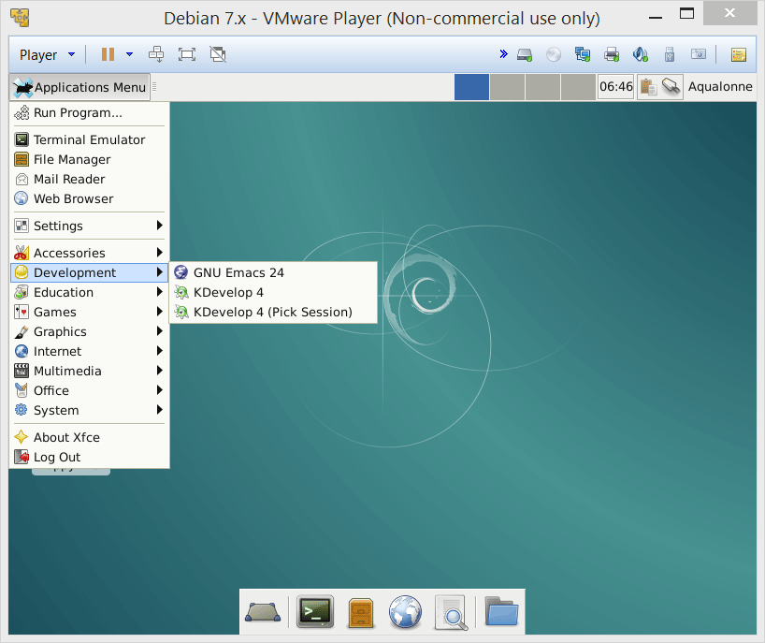
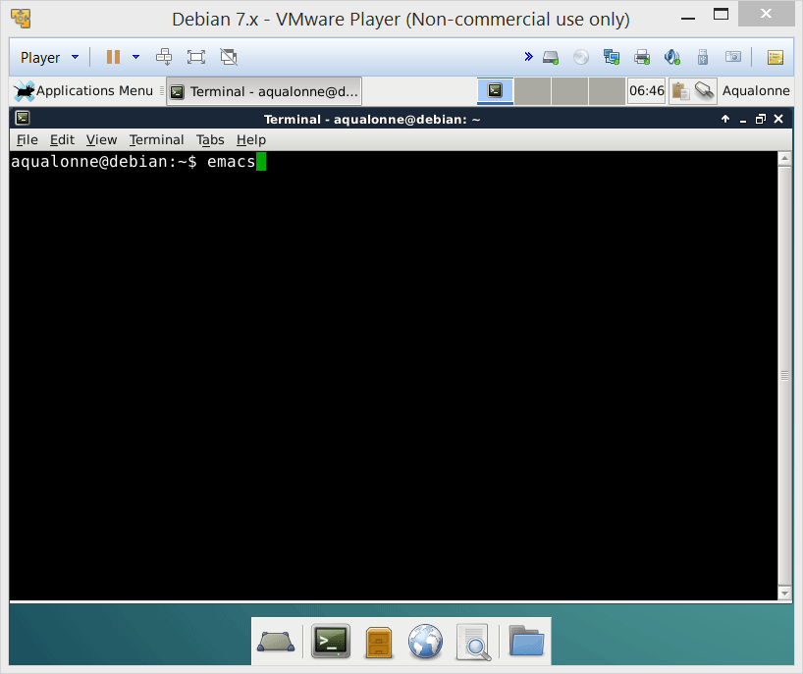
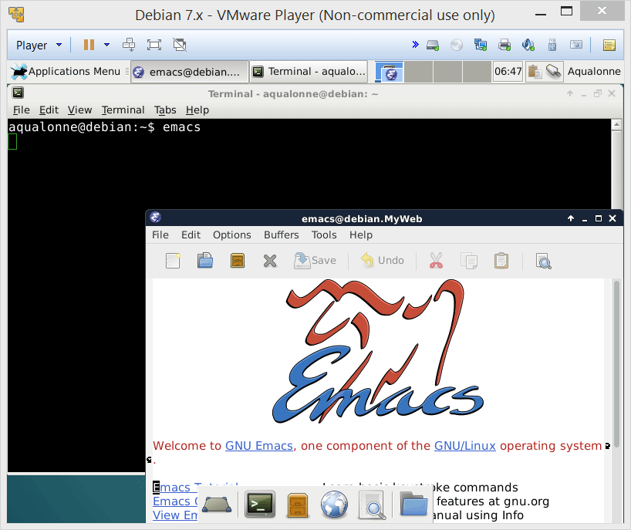
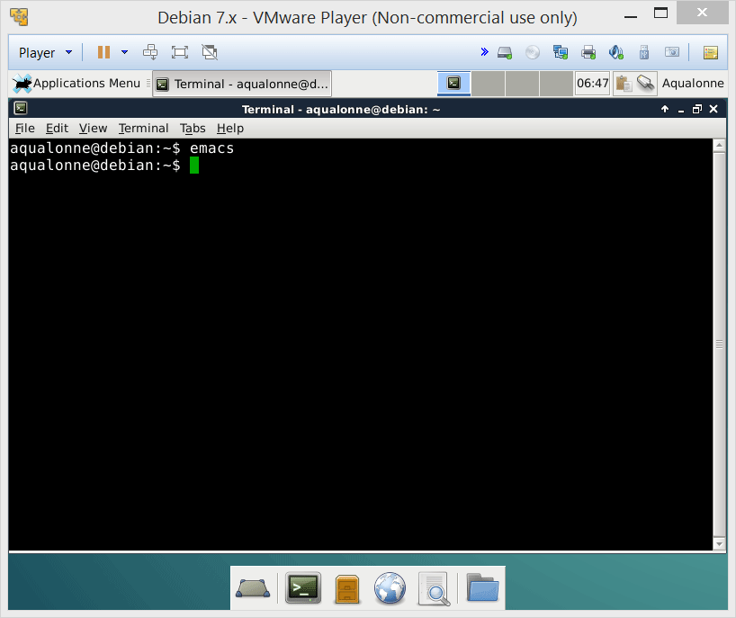

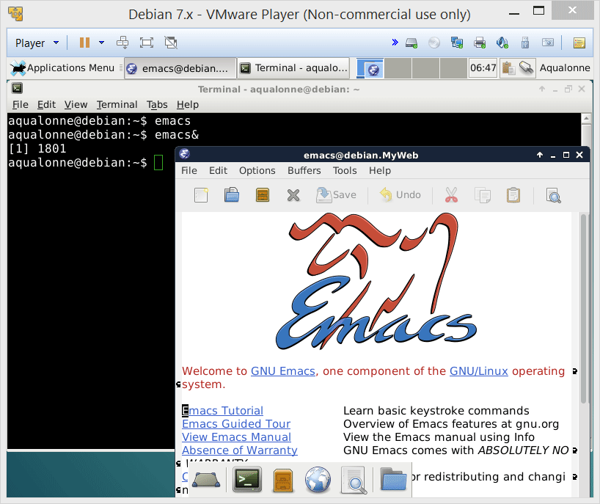
Our editor for this module: emacs
We don’t get the prompt back. Control has now been passed to Emacs, until it ends.
Emacs has a graphical user interface. It cannot reside within the shell. To detach it:
emacs&
& starts a program as an independent task
3
While and for loops

Slide 4
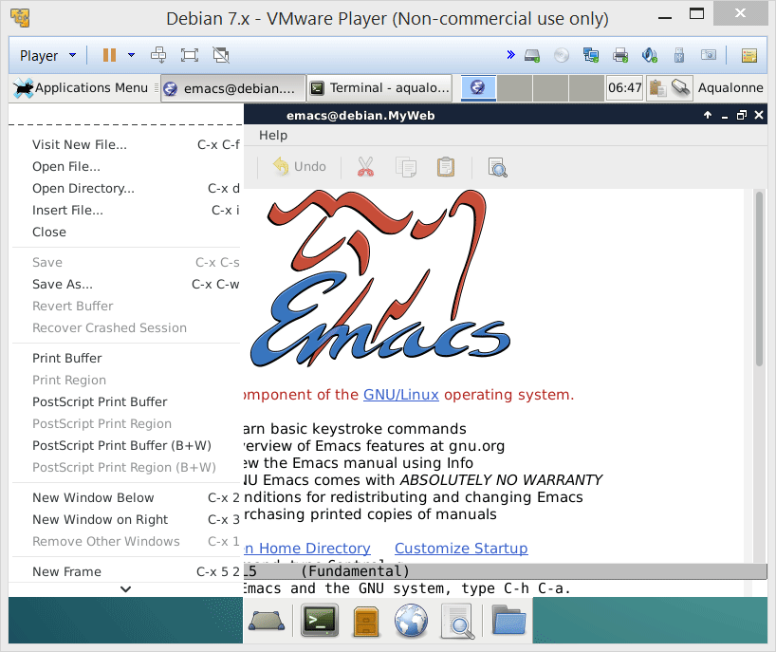
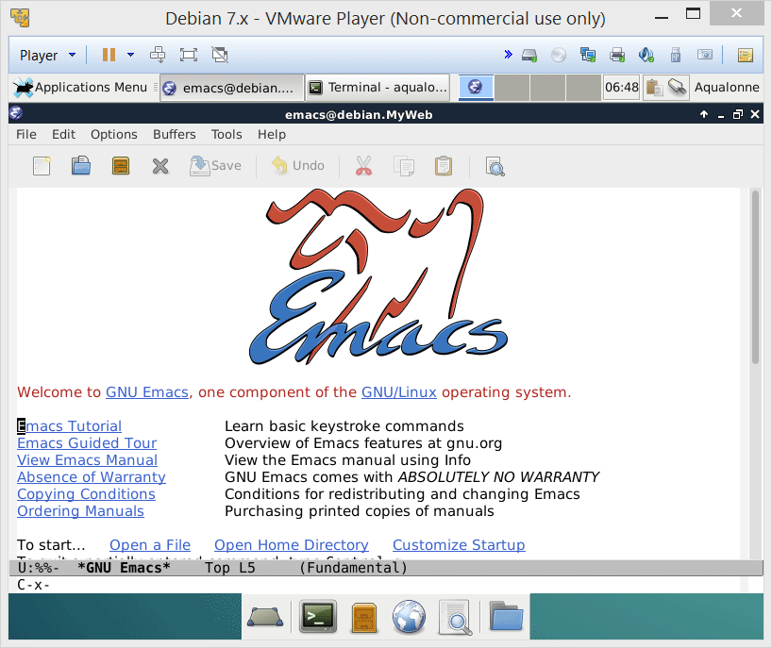
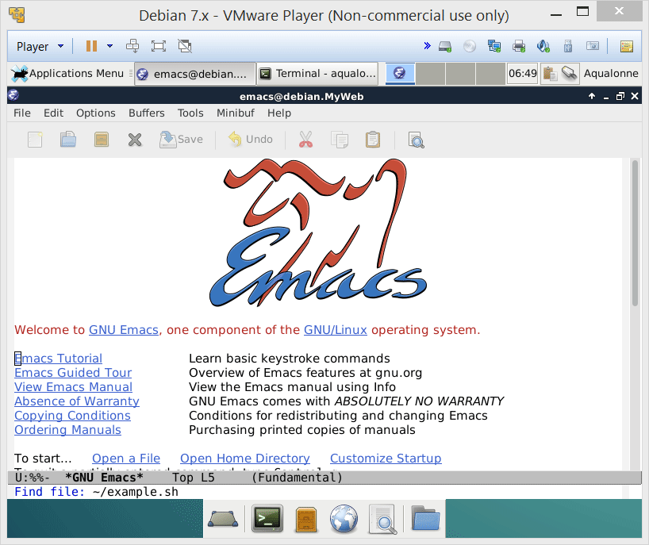
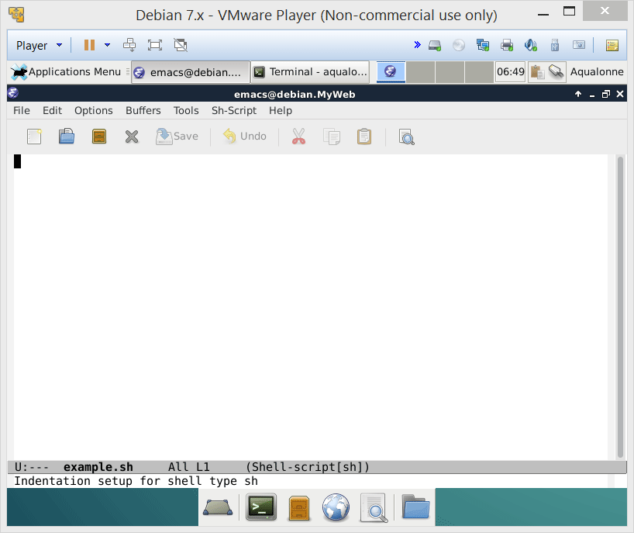
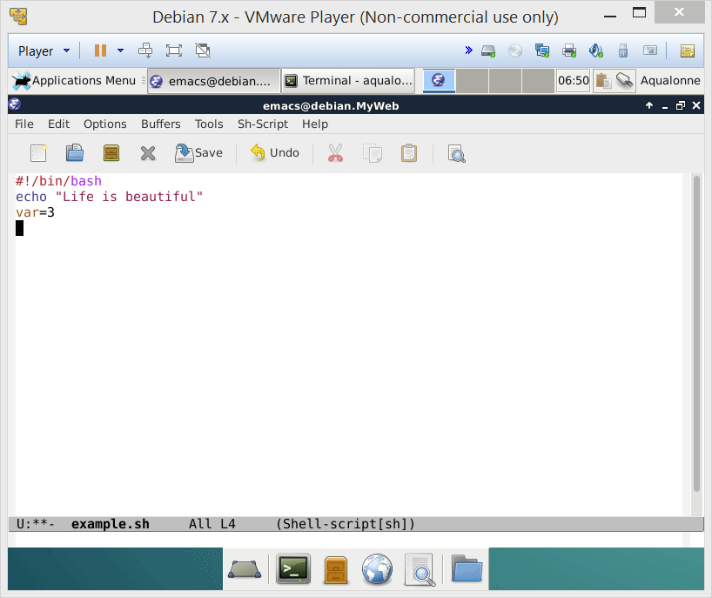
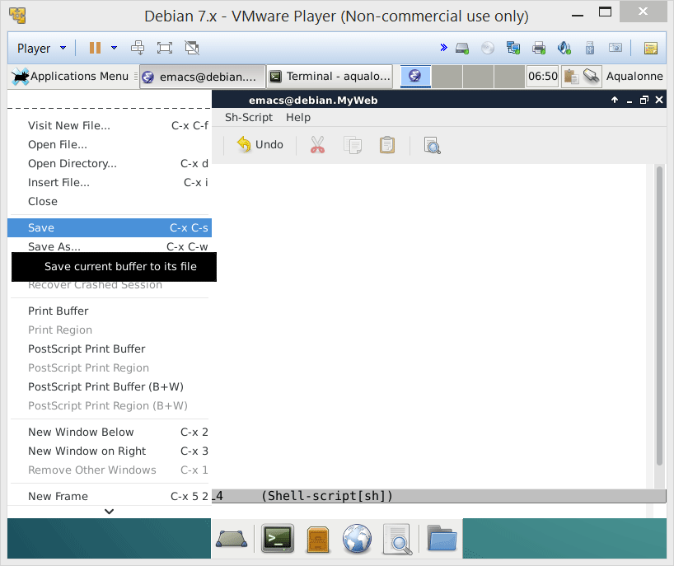
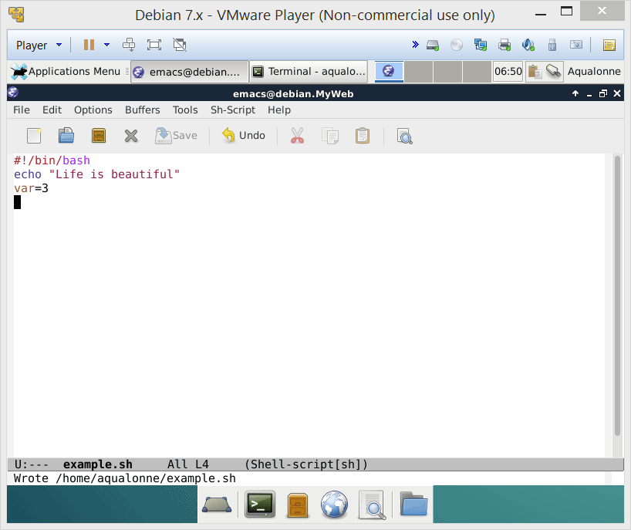
Our editor for this module: emacs
You can do everything Ctrl+... Ctrl+.... but you can also just click in the menus.
It’s giving you options specific to writing a script.
Commands show as you start typing them
4
While and for loops

Slide 5
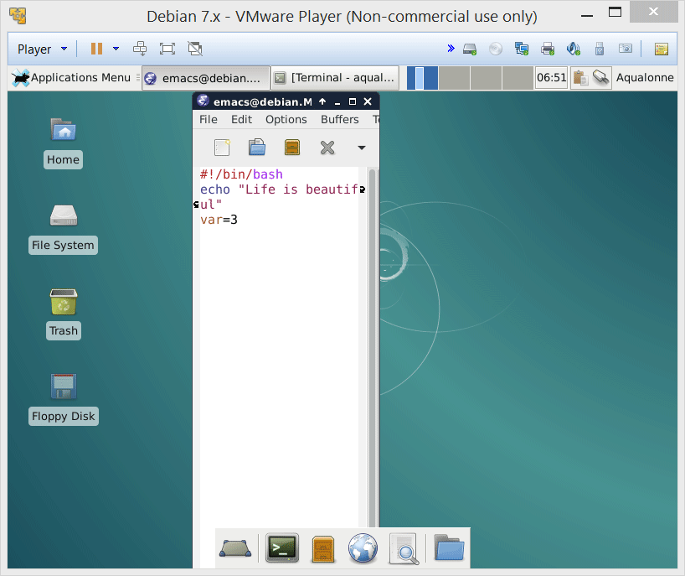
Our editor for this module: emacs
As an aside... If your line goes over multiple rows of display, emacs shows that
5
While and for loops

Slide 6
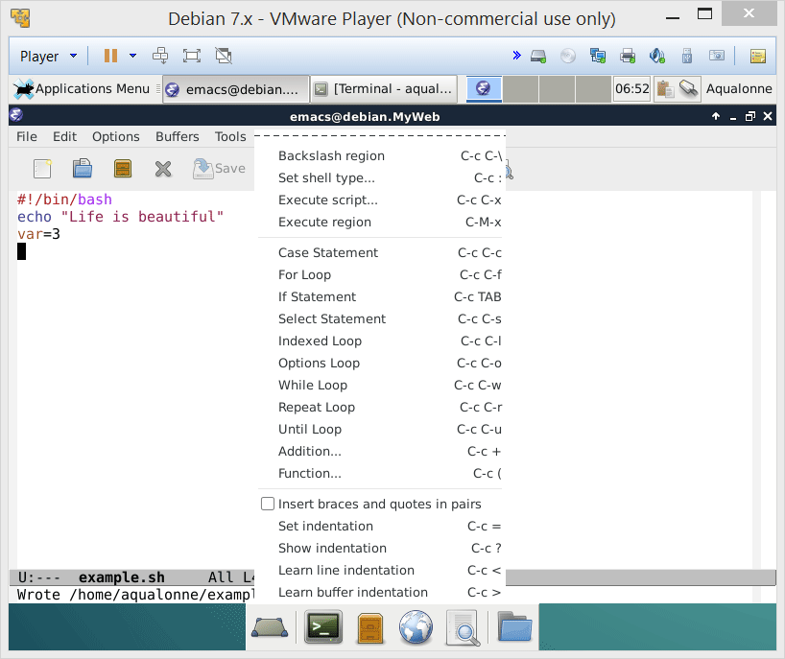
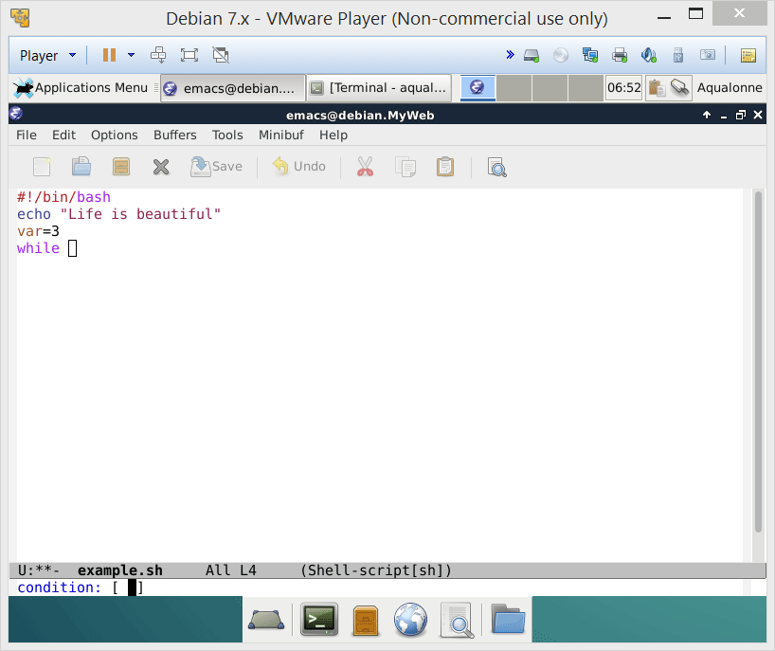
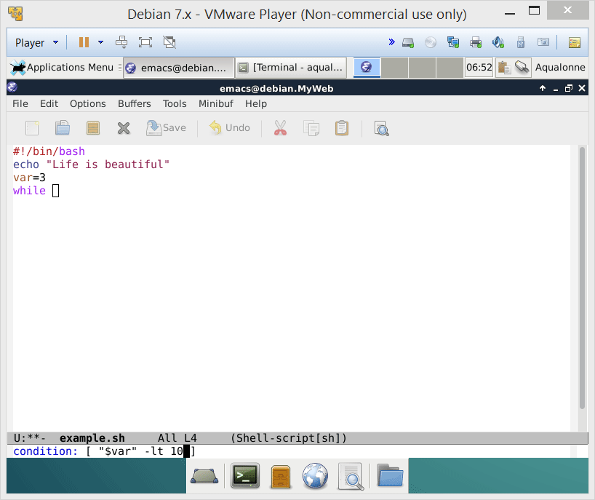
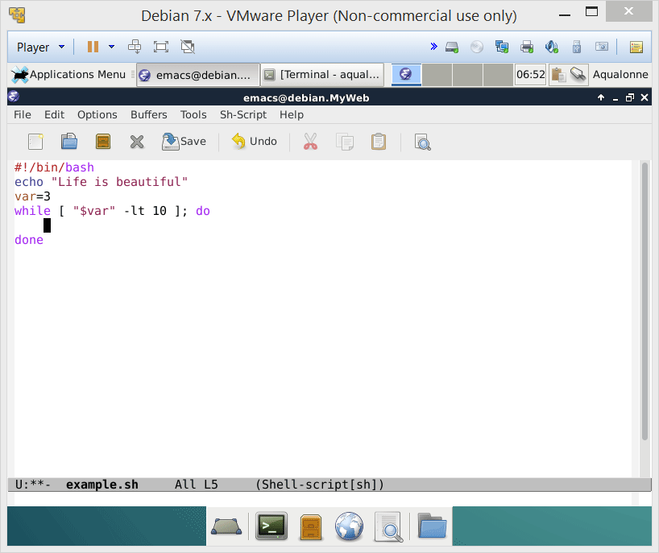
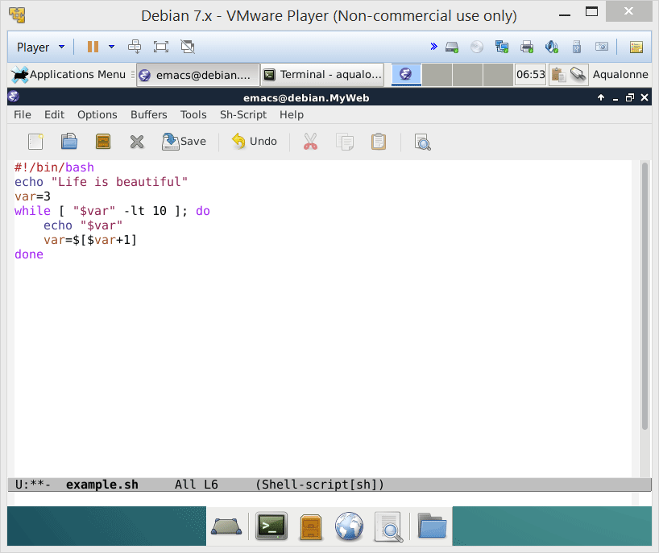
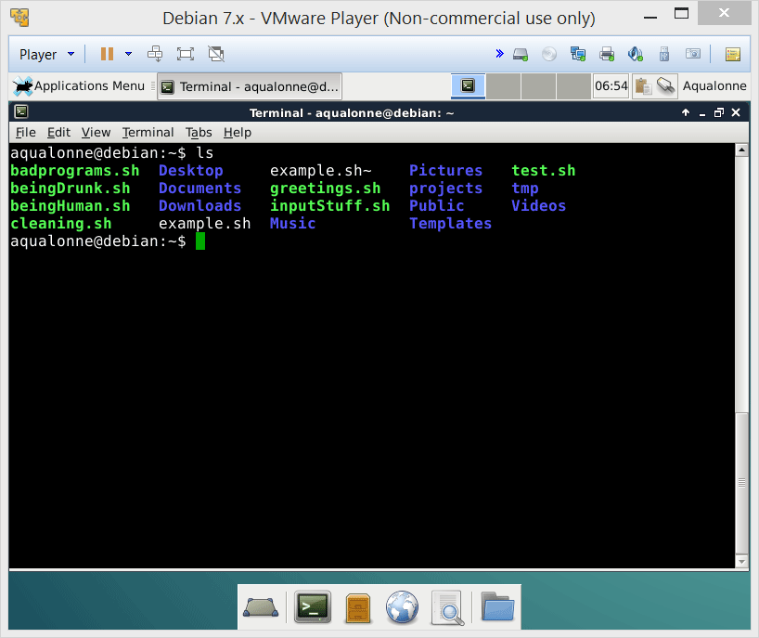
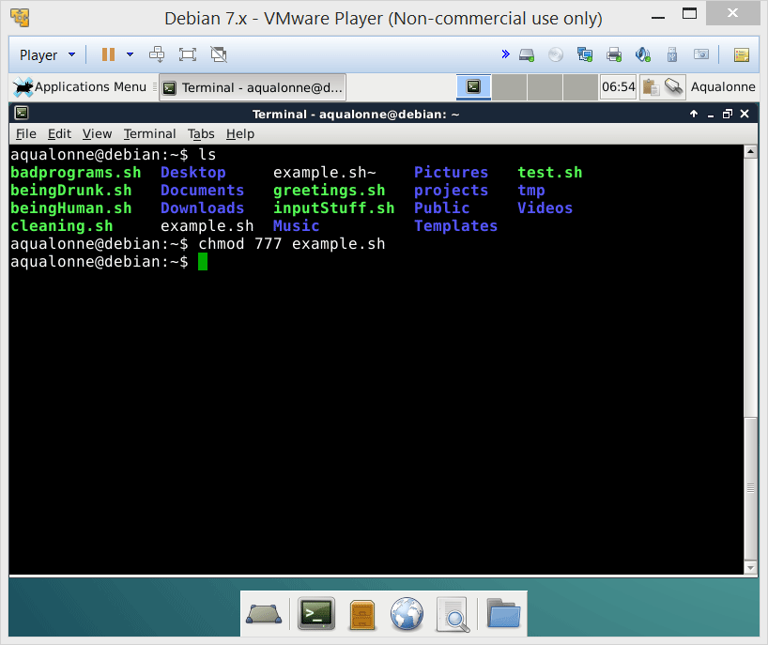
Our editor for this module: emacs
You still need to make your scripts runnable, even to run them from within emacs.
6
While and for loops

Slide 7
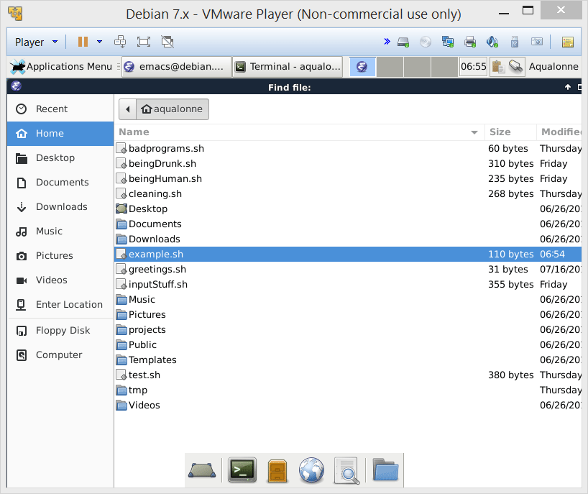
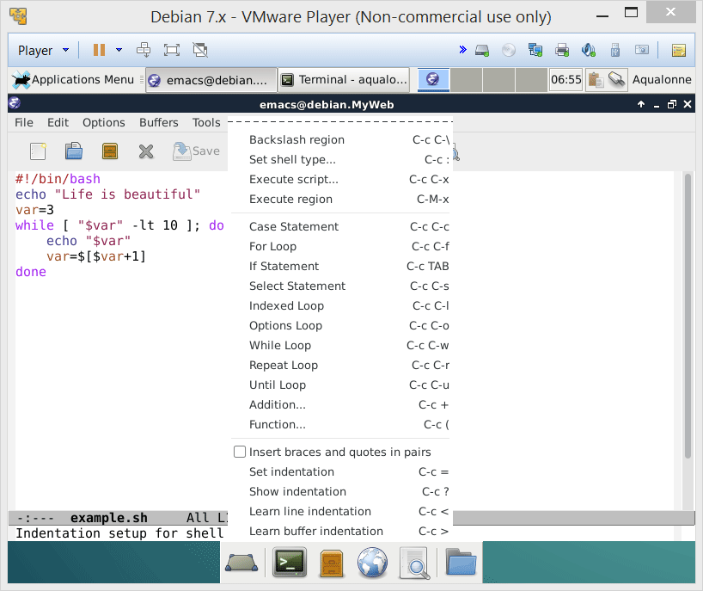
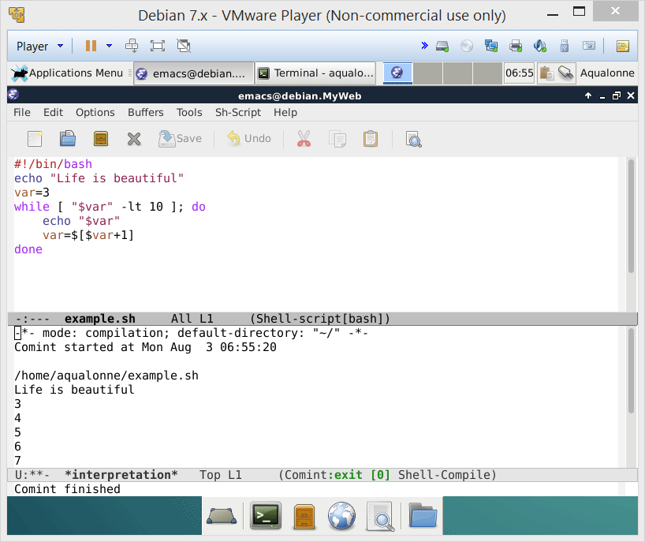
Our editor for this module: emacs
Emacs has templates for control structures, and can run some or all of a script.
7
While and for loops

Slide 8

Our editor for this module: emacs
“It can do all that!
omg omg I’m gonna use it all the time!”
Why didn’t the prof just let us always use Emacs from day 1?
1) He is inherently vicious
2) There are situations in which you can’t use Emacs
When you log onto a machine/computing cluster remotely, you may not have graphics (X11). So you need to know how to work when all you have is your Shell.
8
While and for loops

Slide 9
Overview of loops
9
While and for loops

Slide 10


Overview of loops
You can either loop over
• a command
0
2
4
Start at 0
Stop when reach 4
Increase by steps of 2
• a set
Start at the first item
Are there more items?
Process and move
10
While and for loops

Slide 11
Overview of loops
You can either loop over
• a command
Won’t bother with it
while
until
Stop when reach 4
Keep going as long as it’s not 4
• a set
for..in
select
Are there more items?
Please pick from a menu
11
While and for loops

Slide 12
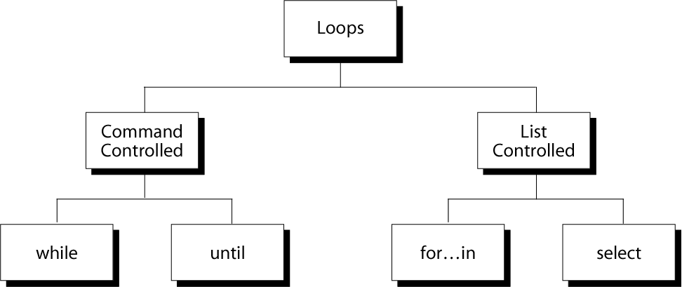
Overview of loops
as long as it’s true or false, keep doing it
ask the user to pick an item in a set (menu-like)
process each item in a set
12
While and for loops

Slide 13
While
13
While and for loops

Slide 14
While
test command
command list
Keep doing this as long as that holds
14
While and for loops

Slide 15

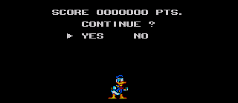



While
Typical uses:
Generating a set of numbers
...
Group 1
Group 8
Keep on doing an operation until the user decides otherwise
Waiting for resources to become available
15
While and for loops

Slide 16
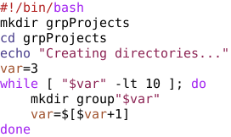
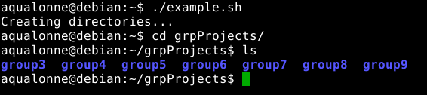
While
Typical uses:
Generating a set of numbers
Example 1:
Create folders for groups 3 to 9
16
While and for loops

Slide 17
While
Typical uses:
Generating a set of numbers
How would you change the script to create folders numbered 10 to 15?
10
16
17
While and for loops

Slide 18
While
Typical uses:
Generating a set of numbers
How would you change the script to create folders numbered 15 to 10?
10
15
-gt 9
16
If the ordering doesn’t matter, it’s up to you whether to count up or down...
-
18
While and for loops

Slide 19
While
Typical uses:
Generating a set of numbers
How would you change the script to create folders with odd numbers, 1, 3, 5, ... til 11?
1
12
+2]
19
While and for loops

Slide 20

While
Typical uses:
Generating a set of numbers
Modify the template to show the value of all arguments.
1
“$#” ];
echo “${var}”
$# is the number of argument
$1, $2, ..., ${10}, ${11} is an argument
20
While and for loops

Slide 21
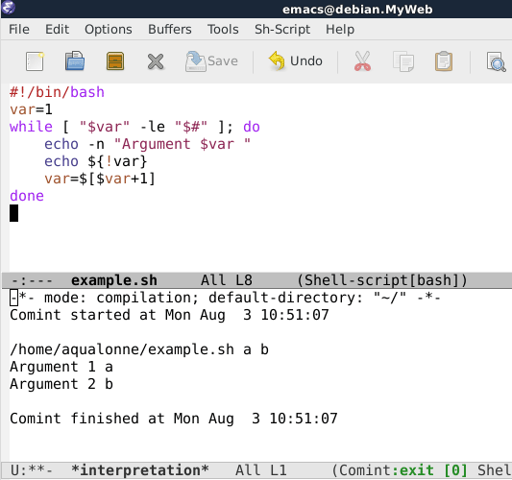

While
Typical uses:
Generating a set of numbers
Modify the template to show the value of all arguments.
Little trick: we don’t want the value of var, but of the argument that it refers to. Using ! performs an indirection.
You can read more about tricks for parameter expansions at:
http://wiki.bash-hackers.org/syntax/pe
21
While and for loops

Slide 22

While
Even though an indirection looks like !, it has NOTHING to do with the ! that we use to say “not”
• In a while loop, ! is an indirection that you tend to use to get a variable by index. It’s always ${! ....... }
• The logical ! (“not”) requires the extglob to be turned on. I can say “not” within a “while” loop... but the syntax tells you what I’m doing.
22
While and for loops

Slide 23
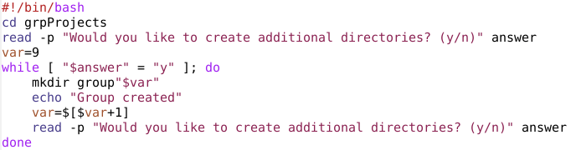

While
Typical uses:
Keep on doing an operation until the user decides otherwise
It would be best if that program remembered its state. That is, when you
call that script, it should know what’s the last group created.
As an exercise, change the script so that it uses a file group.state to
keep track of what’s the last created group. The script should get the
number when it starts, and update it when it ends.
23
While and for loops

Slide 24
While
Practice question #1
Write a script multiTouch.sh that takes two arguments: a file name, and a number of files to be created. For example,
./multiTouch.sh student 10
will create 10 files named student0, student1, ..., student9
Your script should give an error message if it doesn’t get 2 arguments.
24
While and for loops

Slide 25
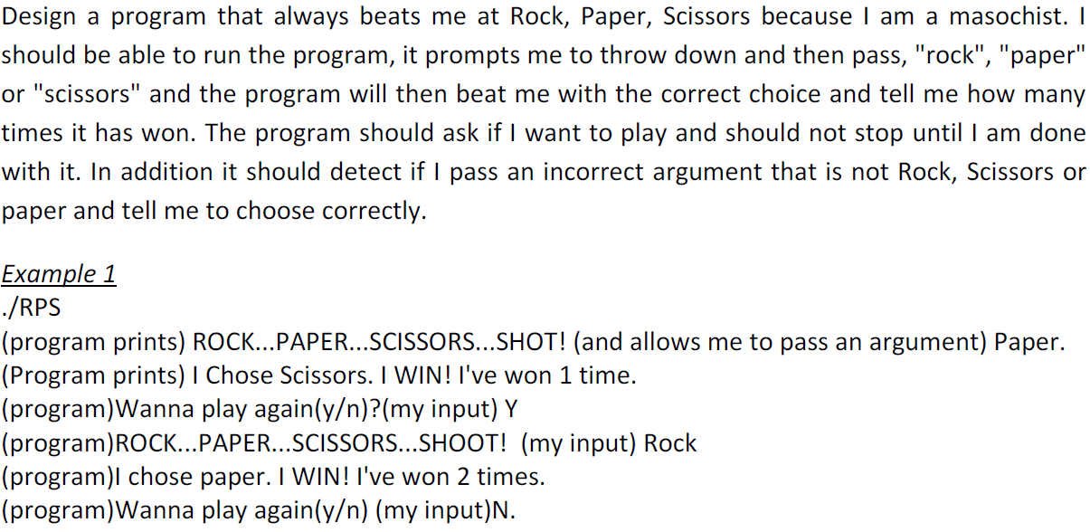
While
Practice question #2
Designed by student
Given in past quiz
25
While and for loops

Slide 26
While
Practice question #3
Write a script sumMe.sh that takes any number of arguments and displays their sum. For example,
./sumMe.sh 1 5 9
should display 15.
26
While and for loops

Slide 27
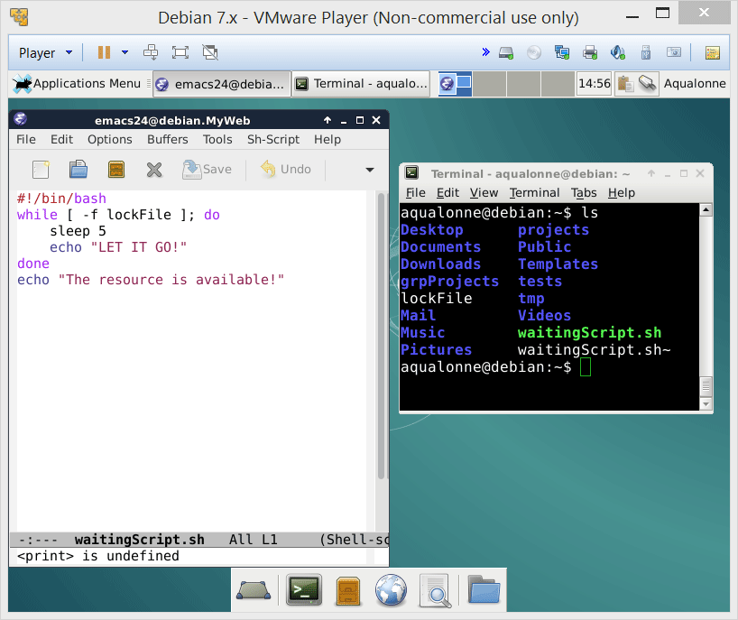
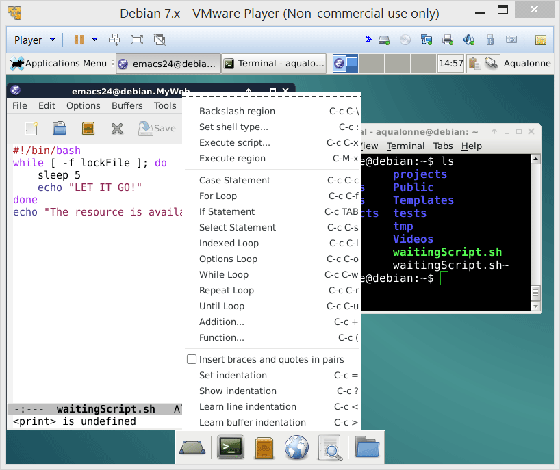
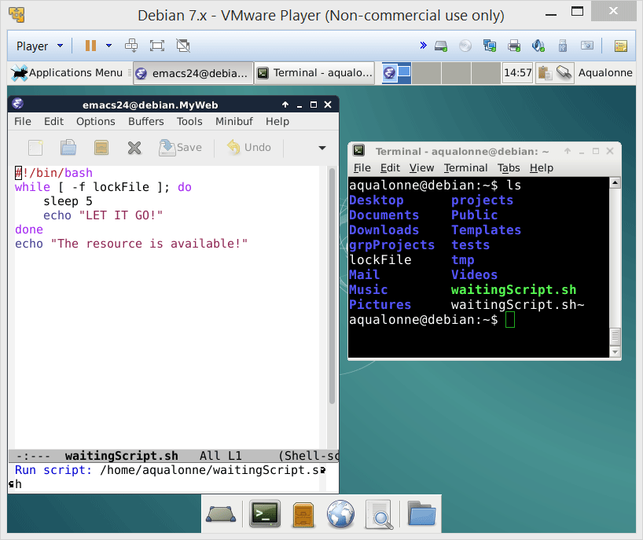
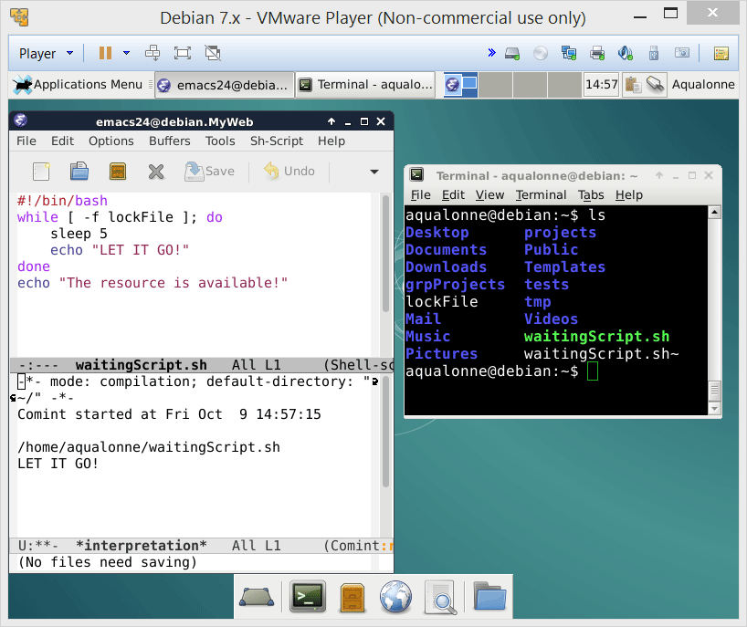
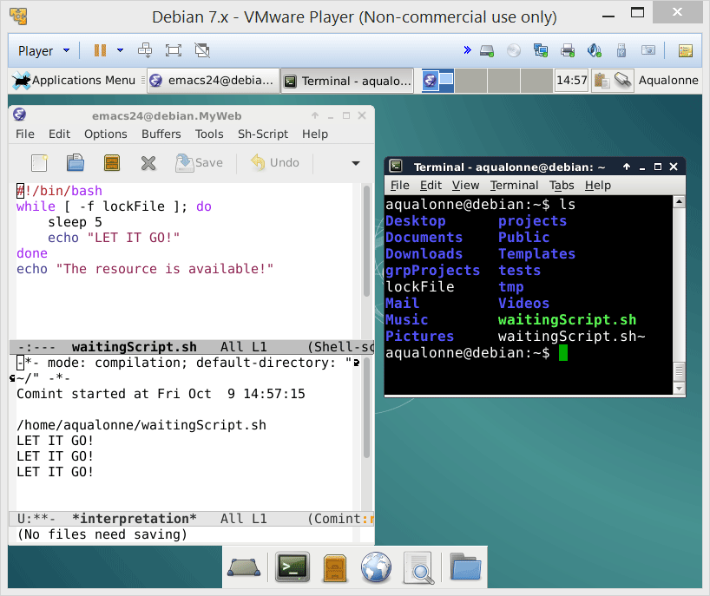



While
Typical uses:
Waiting for resources to become available
If you want to know, just have a look at File locking on Wikipedia!
27
While and for loops

Slide 28


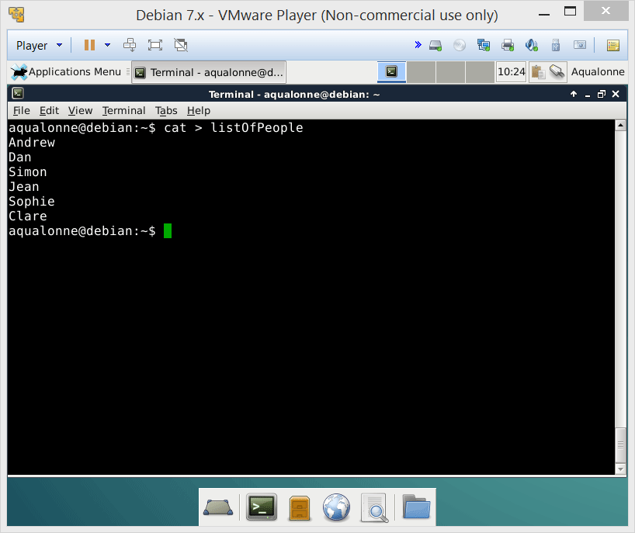
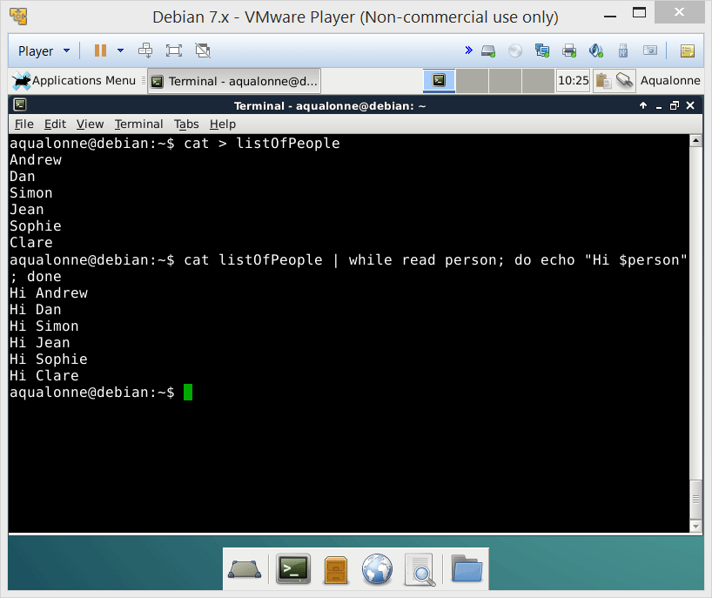
While
You can also pipe control structures.
Note that this example processes each item in a set. We said that the “for..in” structure was for that.
Each line read by cat
is stored in the variable person
So you may be able to get anything done through combinations of pipes etc., but it’s not necessarily the best way to go!
which we display
28
While and for loops

Slide 29
For .. in
29
While and for loops

Slide 30
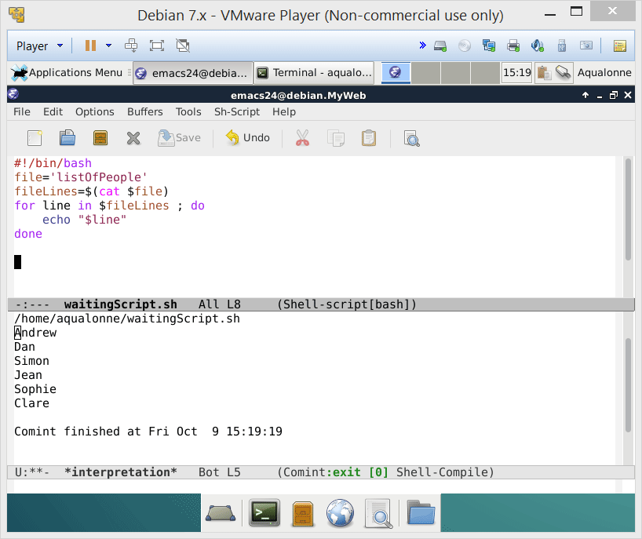
For .. in
Keep doing this for each item in that
30
While and for loops

Slide 31
For .. in
31
While and for loops

Slide 32
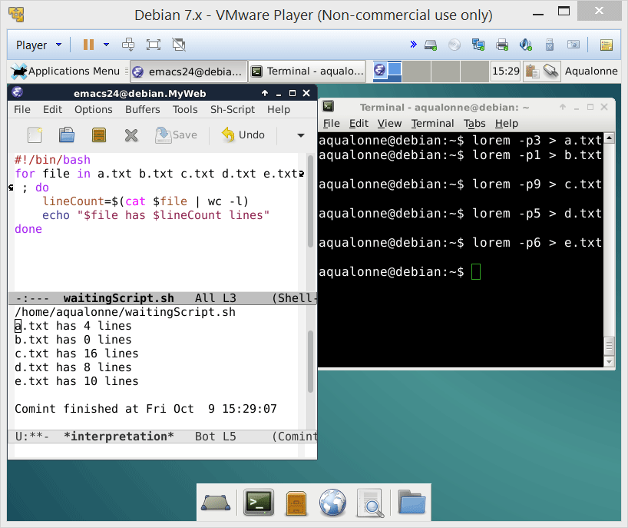
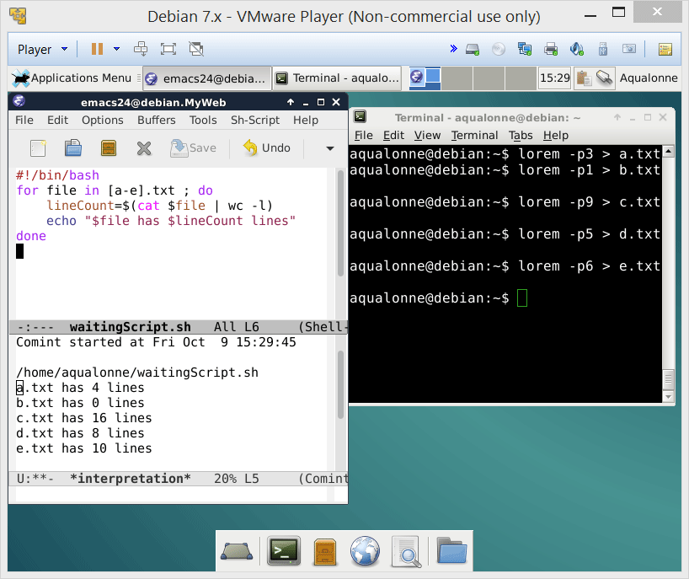
For .. in
Typical uses:
processing a set of files
for ..var.. in ..files.. ; do
32
While and for loops

Slide 33

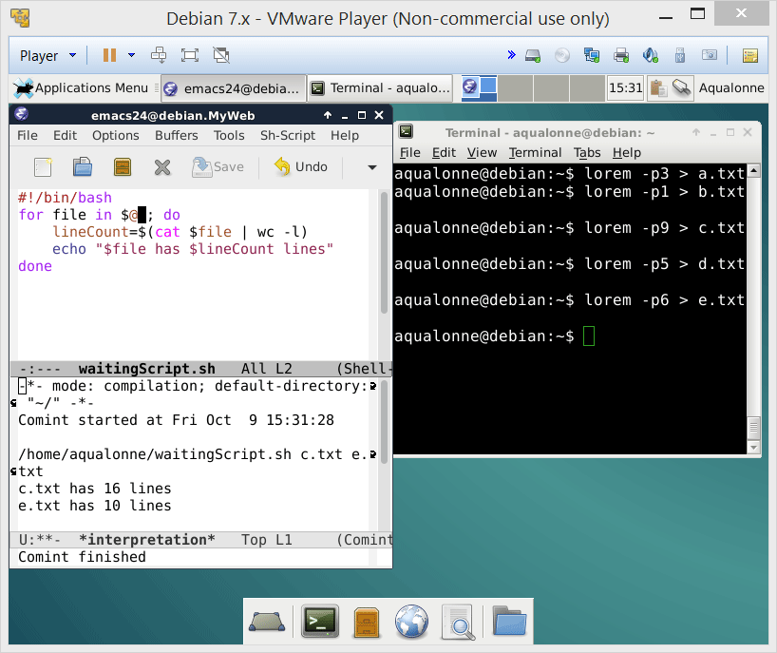
For .. in
Typical uses:
processing a set of files
for ..var.. in ..files.. ; do
processing a set of arguments
Note that if you want to start from e.g. the 2nd argument, you can use ${@:2}
for ..var.. in $@ ; do
...or if you’re feeling lazy, processing arguments is what it does by default:
for ..var.. ; do
33
While and for loops

Slide 34
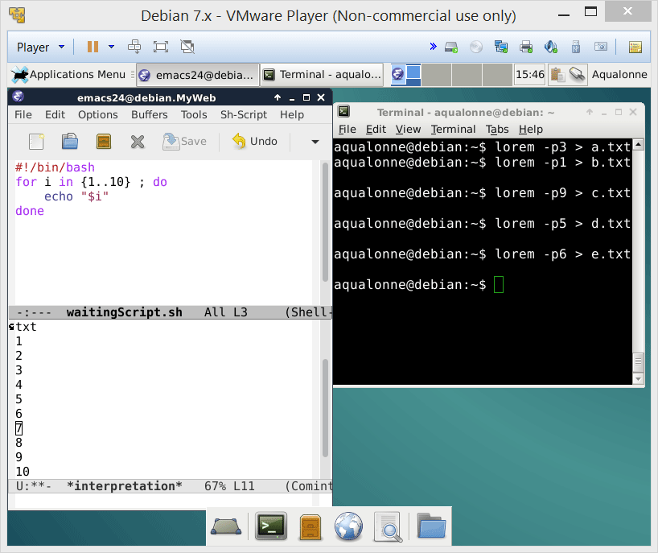
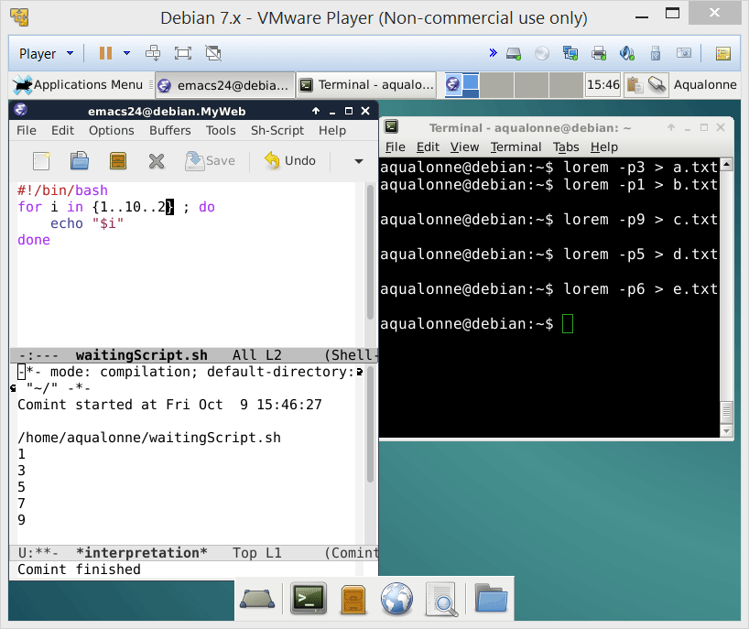
For .. in
Typical uses:
processing a set of files
for ..var.. in ..files.. ; do
processing a set of arguments
increment
start
end
for ..var.. in $@ ; do
generating a set of numbers
for i in {..set..} ; do
34
While and for loops

Slide 35
For .. in
Practice question #1
Write a script multiTouch.sh that takes two arguments: a file name, and a number of files to be created. For example,
./multiTouch.sh student 10
will create 10 files named student0, student1, ..., student9
Your script should give an error message if it doesn’t get 2 arguments.
Practice question #3
Write a script sumMe.sh that takes any number of arguments and displays their sum. For example,
./sumMe.sh 1 5 9
should display 15.
35
While and for loops

Slide 36

Loop practice
Let’s warm up through short practice questions!
Imagine that you're writing a program that operates a satellite. The satellite is a shared resource, as other programs might be using it. In the folder /bin/satellite, there is a file named lock when the satellite is used.
Write a script that just shows the message “Transmitting” when it gets access to the satellite. You can use any type of loop you want it for this.
Write a for loop that takes numbers as arguments, and displays the smallest number.
Write a script that takes two arguments: a number, and a folder. It creates as many empty files as stated by that number, in that folder. It’s up to you what the files are called. Use a for loop.
36
While and for loops

Slide 37
Real-world uses
37
While and for loops

Slide 38

Real-world uses
Write a script that takes two folders as arguments. The first folder is the source, the second folder is the backup. If a file from the 1st folder does not appear in the 2nd, then it should be copied there.
Pseudocode:
Script syntax:
cd $1
for file in * ; do
for each file in folder 1
if the file is not in folder 2
copy to folder 2
if [ ! -f “$2”“/”“$file”] ; then
cp “$file” “$2”
38
While and for loops

Slide 39
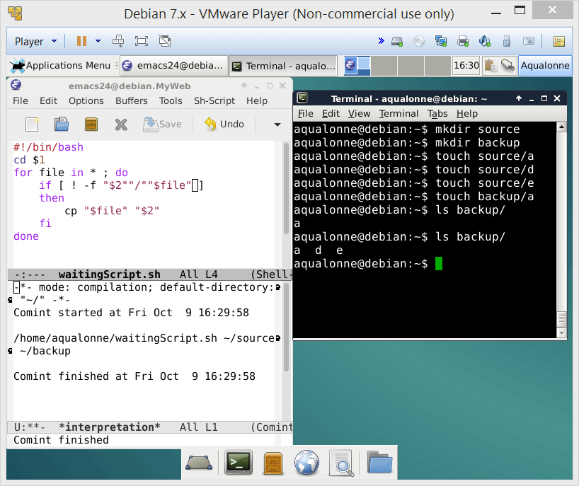
Real-world uses
39
While and for loops

Slide 40
Real-world uses
Write a script that takes an argument as folder. For each file in that folder, if the file is a text file, then the script adds the extension .txt to the file.
Pseudocode:
for each file in folder
if the file is text
add extension .txt
40
While and for loops

Slide 41
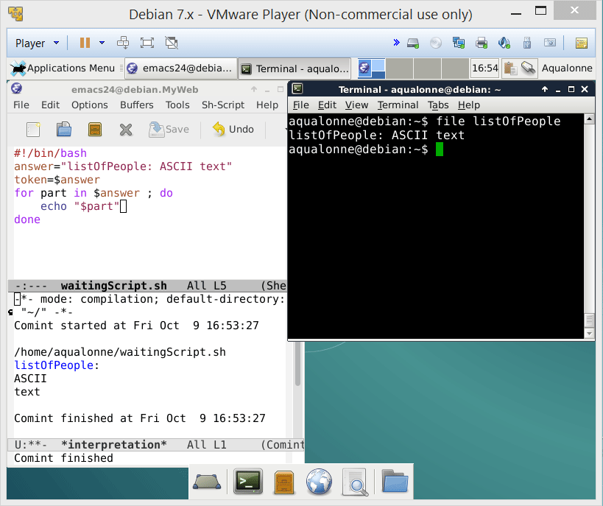
Real-world uses
You can use the command file to know if it’s text.
You can use a for loop to move through the answer.
41
While and for loops

Slide 42
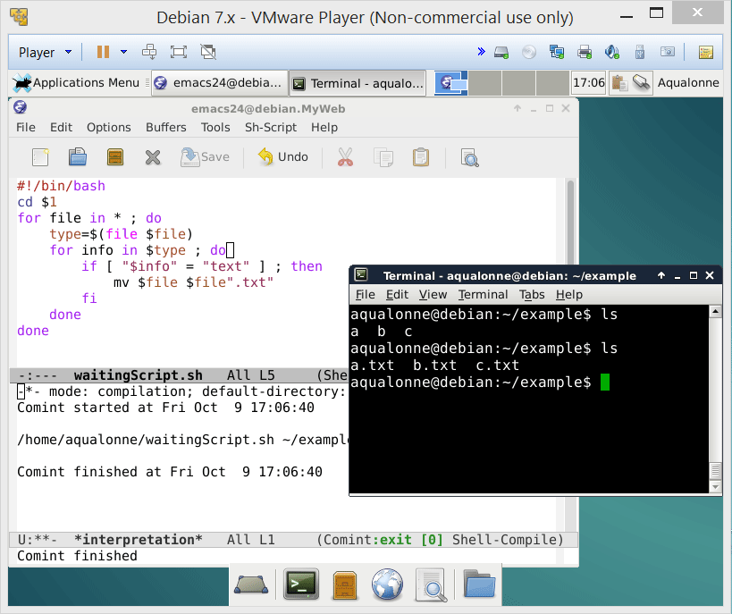
Real-world uses
42
While and for loops

Slide 43
Real-world uses
For each file in the folder
Ask for the type
If the answer includes “text”
Add .txt at the end
43
While and for loops

Slide 44

Getting your first practical scripts to work is known to be a pleasant and relaxing experience ☺ But now... you know how to do it!

Slide 45

45
While and for loops

Slide 46

To go further on loops, you can check out these 4 commands:
until
select
break
continue
46
While and for loops

Slide 47
More practice
Write a script myCat.sh that takes any number of arguments, all having to be files. It shows the content of the first one, followed by the second one, etc. You cannot use the command ‘cat’ in this script.
Write a script that replaces the content of all files within the current folder, ending with the .X extension, with the message “No naughty files allowed here”.
Create a script called finalCountDown.sh. This script should display to the user that, "ITS THE FINAL COUNT DOWN!!" Then it should prompt the user to enter a positive number. If the user did not enter a positive number, display an error message and exit the program. If the number is positive, count down from the number entered by the user until 0. Each number should be displayed on the screen at an interval of 1 second, and the screen should be cleared before the appearance of the next number. Once the number is equal to 0, display the message "Ka-Boom!!" There should also be a one second interval between the 0 and "Ka-Boom!!"
47
While and for loops

Slide 48




The two two weird things not to do about For .. in
2
weird uses of Linux for loops
48
While and for loops

Slide 49

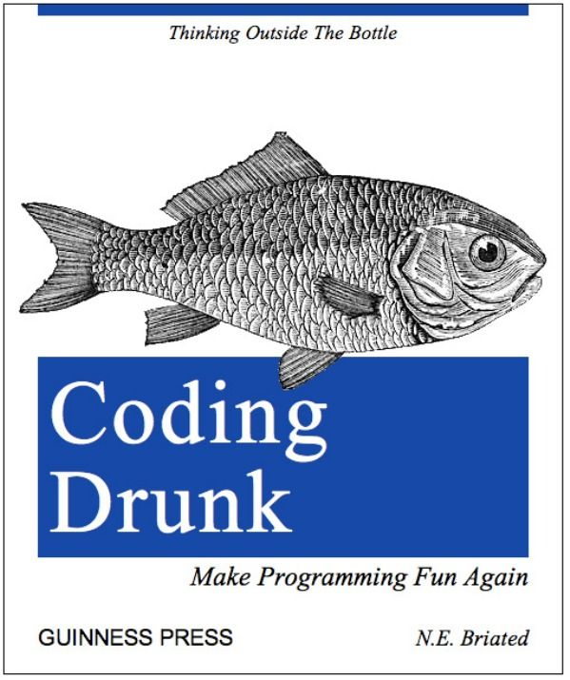
The two two weird things not to do about For .. in
1
Go through ad-hoc numbers
49
While and for loops

Slide 50


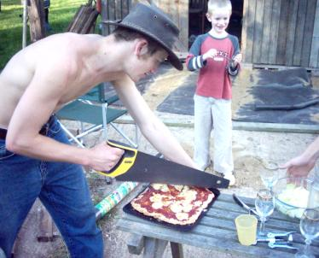
The two two weird things not to do about For .. in
2
Writing C code cause why not
50
While and for loops

